Slide 1
Non Expert's Guide to Creating Personal Projects
Austin G. Imperial
Notes:
Please let me introduce myself, My name is Austin G Imperial, I started coding when I was 11yrs old without no idea that I was actually coding. It all started from an online Windows game. I got curious on how a particular hack worked, so I asked this person who made the hack on how he did it, luckily because of my eagerness to learn, we exchanged emails and he taught me how to edit a special file type that the game used called SQF using only a “notepad” [until we discovered sublime text]. My curiosity led me to modifying an XML file for another game named Spin Tires.
I am not here to teach you the technical sides of Python which I am sure you are far better than I am but rather share my ideas and thoughts on how to start your own personal projects in Python.

Slide 2
Three Types of Codes
 | Society | Self
Useful : Useful
Useless : Useful
Useless : Useless
Notes:
When I first heard Chad Estioco's talk about Making Use of Useless things, I was so proud of myself that I was doing the right thing and not wasting my time writing codes, like a mini computer inside a computer, a calculator and some random codes I can not and will not share to you for shameful reasons.
And now in my own opinion there are three types codes.

Slide 3
Useful : Useful Code
Useful for the society
Useful for coding skills
Society | Self
Notes:
a code that solves a problem and enhances your problem solving skills

Slide 4
Useless : Useful Code
The society will not benefit from it but still enhances your coding skills
Society | Self
Notes:
It does not solve a problem but will hone your coding skill
<Rock, Paper, Scissors>

Slide 5
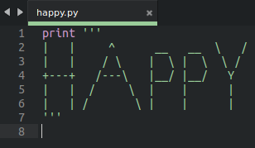

Useless : Useless Code
Neither you or anyone else would benefit from this code and is just a total waste of time and effort but still entertaining at the very least especially when you are starting to explore the “basics” (print “Hello World”) of what you have learned :-)

Slide 6
A python beginner or hobbyist should focus on doing a project based on 1st and 2nd type of code but try NOT to stay away from 3rd type of code because it may/can still give you terrific idea of not doing IT the second time around :-)

Slide 7
How do you make a useful code?
To make a personal project, you need to have the following:
Idea
Problem
Solution
Inspiration
Notes:
idea = this is my biggest problem. you're stuck at doing nothing without an idea on what to do, you can not have a solution to any problem without having first a “pyidea” :-)
problem = what could be the possible problem for you to solve and exercise your brain muscles
solution = so you have a problem, then go figure how to solve it, make a flow chart or pseudo code like what I have found in wikipedia for my last project, sudoku solver <insert example in solving the sudoku solver (backtracking)>, use your imagination
inspiration = I do not know the reason why you need an inspiration, but most adults suggest that “success is 99% perspiration and 1%inspiration”, you should all know this that I am not responsible with this quote, maybe when this quote was written an airconditioner was still unheard of :-)

Slide 8
Where to get an idea?
While some of my projects are mostly:
Due to boredom
Inspired from another project that I or we have stumbled upon the web
Challenge from random websites
Based on techniques I have learned from various internet resources

Slide 9
Where to get an idea?
You can get ideas from:
Like minded people like you guys
By joining online communities in G+
Random “legit” websites based on your interest
MOOCs or Massive Open Online Course like edX, Coursera, Udacity and many others
Friends/families
Look out of the window [of a house or car] observe
Daydream
Notes:
friends/families = you can get an idea simply by having a conversation or discussions with your friends and families. Have a social life, not an online social life but a “real” social life. Like this meetup we are having right now. No programmer must be deprived of their own social life.

Slide 10
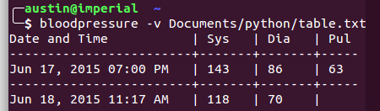
Define the problem
It could be from your daily routines or activities
Friends and families' task or problems
How to or how do you simplify things?
How to be more productive?
Notes:
Friends/families = bloodpressure
Simpllify = How to fit a rectangle inside another larger rectangle http://www.ime.usp.br/~egbirgin/publications/blm.pdf
this is one of my problem everytime the class is suspended or we have a long weekend. I need to be more productive so I try not to waste my precious time just by sitting in front of the computer. I need to do something, if coding is not an option then I switch my interest to using Blender and have a relaxing moment like when you are drinking your coffee. I need to find a tool to simplify things

Slide 11
Find a solution
Some coding problems can be solved by using your common sense or by asking a “normal” person (no pun intended) who doesn't know how to write a single line of code
Consult other programmers thru Stackoverflow or other social media by asking the right question
  “How To Ask Questions The Smart Way”
    By Eric Steven Raymond & Rick Moen
    http://www.catb.org/~esr/faqs/smart-questions.html

Slide 12
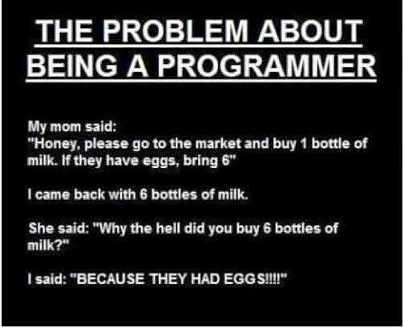
Find a solution
Think like a machine
The bug can be a simple character or mistyped word, do not lose hope :-)
Simplifying another existing problem
Applying past solutions or algorithms to your current project
Notes:
Another effective technique for me is by thinking like a machine. I know most of you are already familiar about the problem of being a programmer but I would like to share it any ways...

Slide 13
Find a solution
Spend some time sleeping since scientists said that sleeping on a problem is the best way to solve it
Set aside your current project (temporarily) since you do not have a deadline and maybe start a new one until you finally figure it out how to solve it
Notes:
I dont know how true it is but it wouldn't hurt if you try.
REMEMBER we are talking about personal projects here so there's no pressure for you to finish it ASAP

Slide 14
Where to get inspiration?
Daily activities/routine
Friends/families' needs or wants
Other people's projects

Slide 15
Useless : Useless Code
This useless code can also be an INSPIRATION for you to write BETTER and BENEFICIAL code in the future
Notes:
I have no other example to show to you aside from the happy.py because it was my first and last useless code I wrote.

Slide 16
Personal projects depends on different variables. Input of ideas, your interest, even your mood has a great impact on your future code/project

Slide 17
Austin G. Imperial
“Student by day; Programmer by night”

